Slide 1
Data structures and algorithms In JavaScript

Slide 2
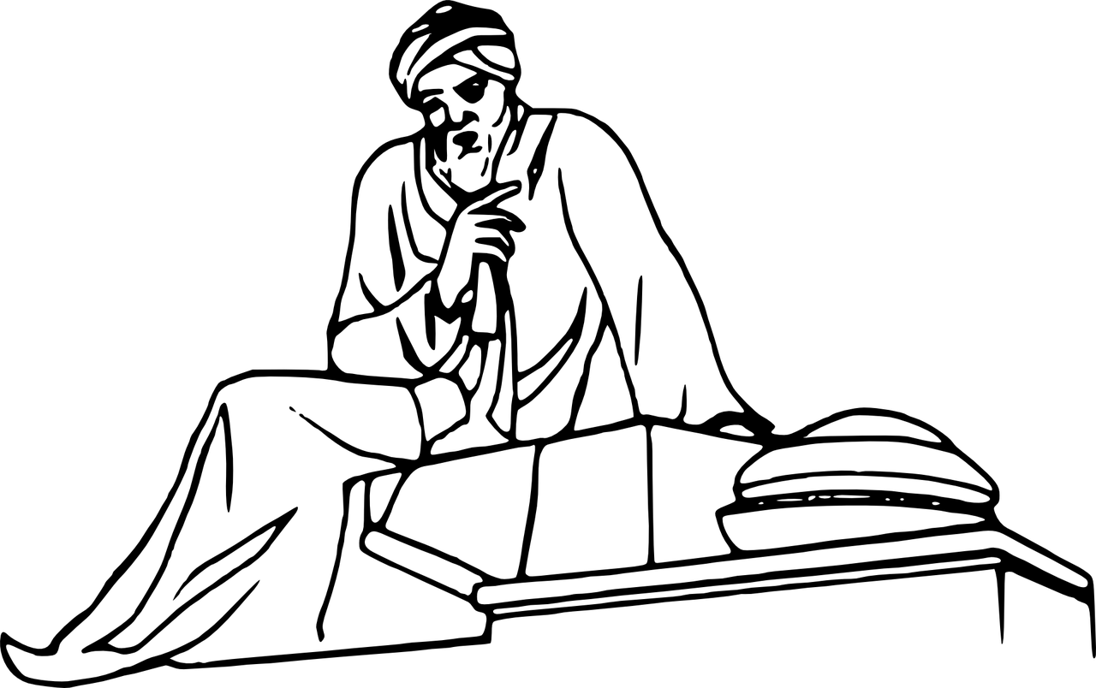
What is An Algorithm?
Algorithm:
set of steps that will solve a particular problem for us.

Slide 3
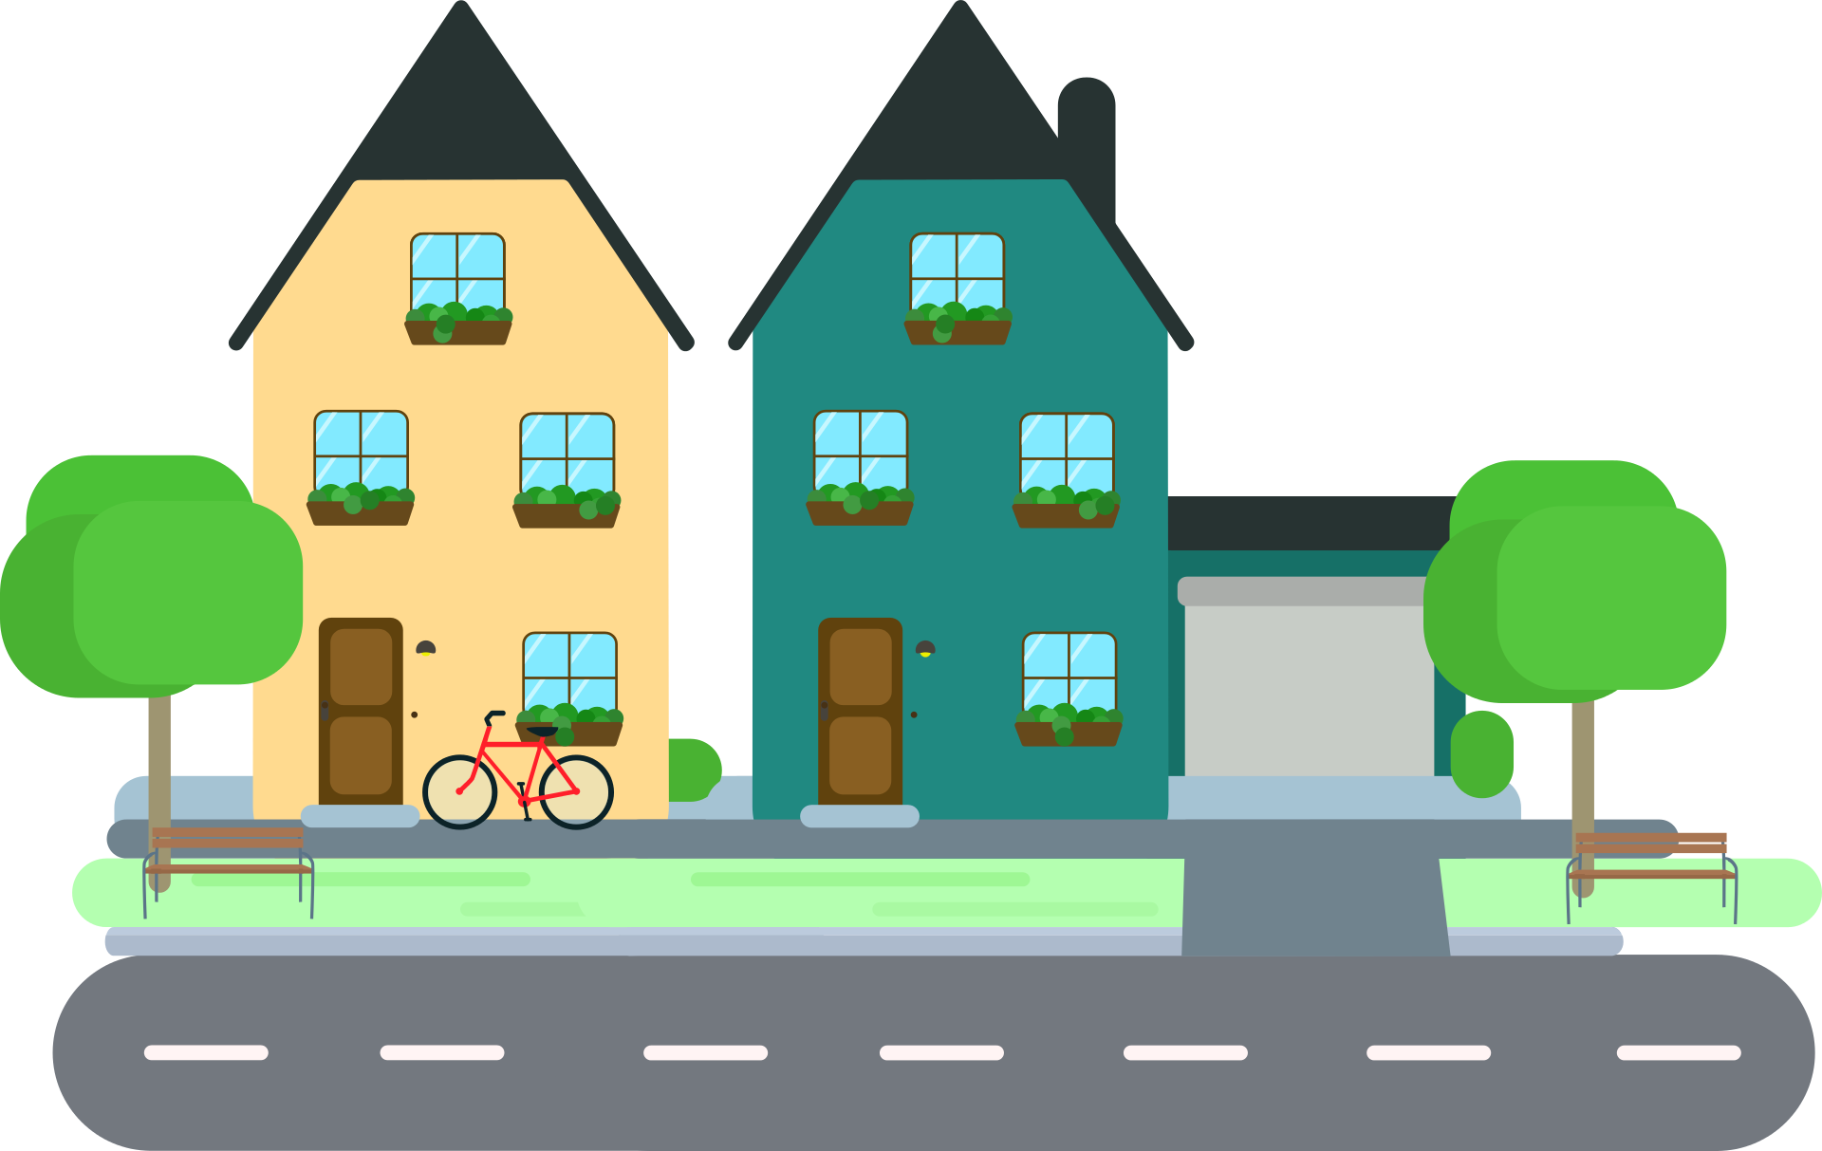

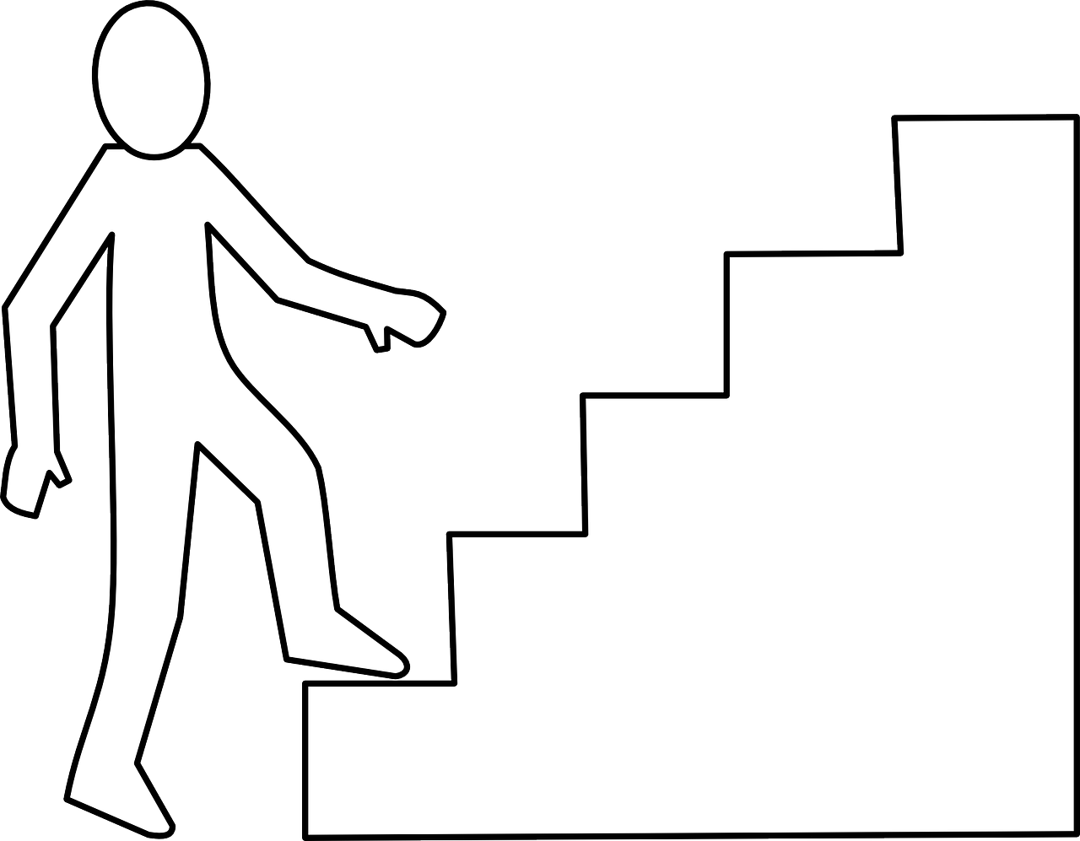
Algorithms In our life
Algorithm:
set of steps that will solve a particular problem for us.
Algorithm1
Walk to your home
Use stairs to go up

Slide 4
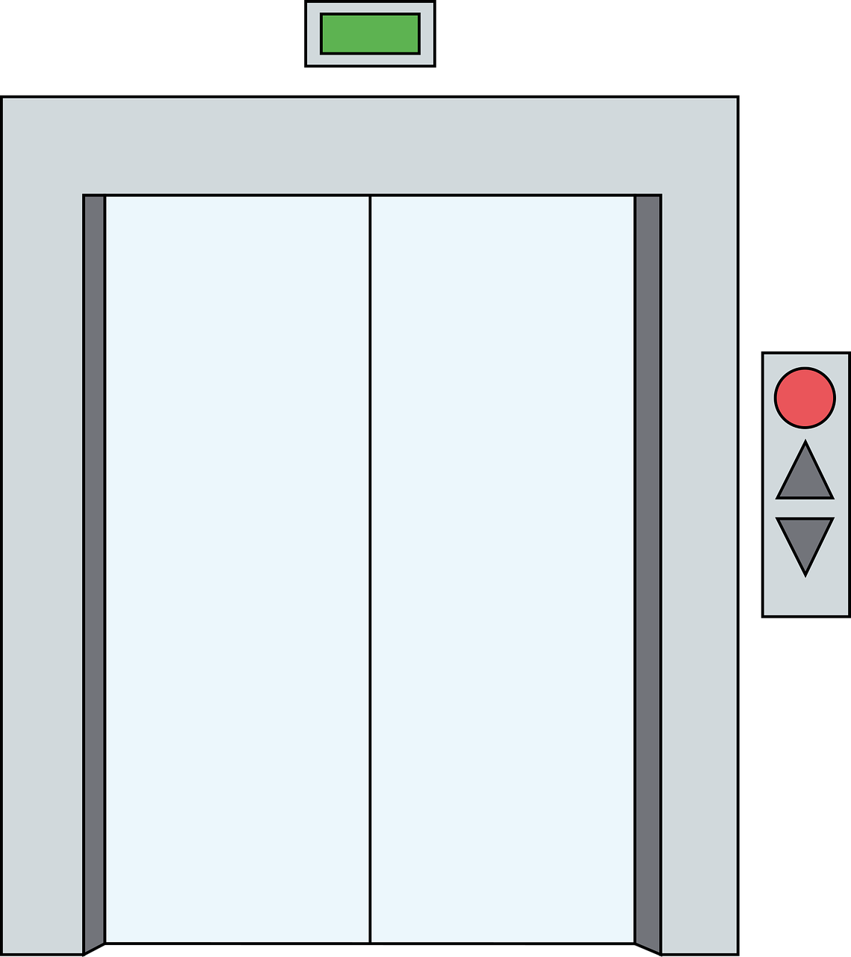

Algorithms In our life
Algorithm:
set of steps that will solve a particular problem for us.
Algorithm2
Take a Taxi
Use the elevator

Slide 5
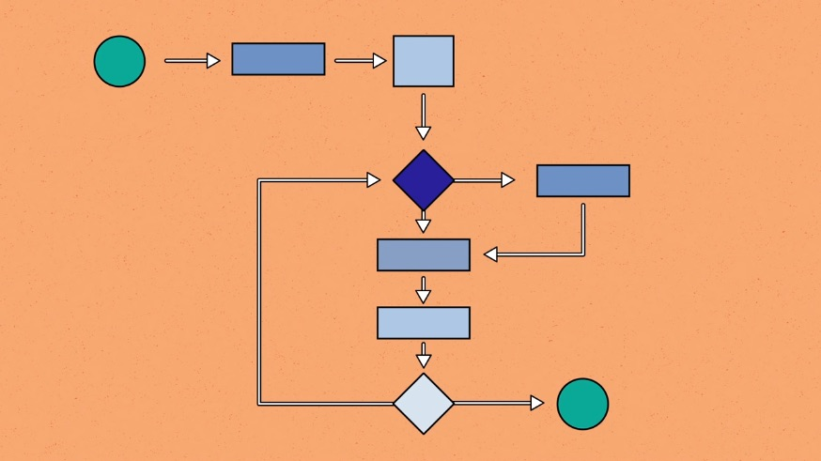
What is An Algorithm
Algorithm:
set of steps (instructions) to solve a particular problem. It takes a set of input and produces a desired output.
Example:
An algorithm to add two numbers:
Take two number inputs
Add numbers using the + operator
Display the result

Slide 6
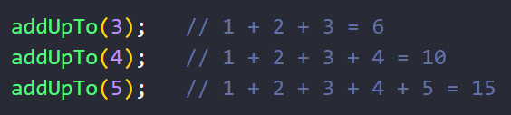
Let’s write our first algorithm
Example
Write a function called addUpTo that takes a number (n)
and returns the sum of all the numbers from 1 to n

Slide 7
Solution steps
1- define function that takes one parameter n.
2- define sum to be zero.
3- loop from 1 until we reach n and every time add to sum the value in the loop.
4- return the sum.

Slide 8
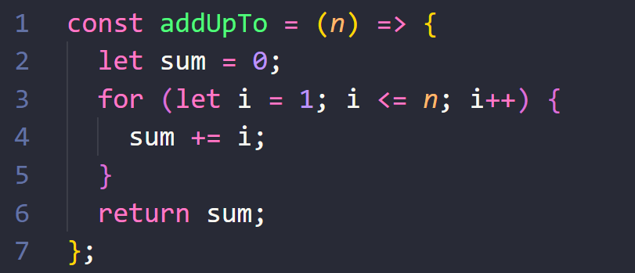
Solution 1

Slide 9

Assignment
Freecodecamp
First five problems
https://www.freecodecamp.org/learn/javascript-algorithms-and-data-structures/#basic-algorithm-scripting

